Slide 1

LangGas: Introducing Language in Selective Zero-Shot Background Subtraction for Semi-Transparent Gas Leak Detection with a New Dataset
Wenqi Guo^{1,2}, Yiyang Du^{2,3}, Shan Du¹
¹Department of CMPS, University of British Columbia, Canada
²Group of Methane Emission Observation & Warning (MEOW) , Weathon Software, Canada
³Department of Computational Linguistics, University of British Columbia, Canada

Slide 2
Introduction & Motivation
Problem: Gas leaks are hazardous (environmental, safety). ​​
Traditional Detection: Human inspection is slow and labor-intensive. ​​
ML Approaches: Existing methods face challenges due to a lack of high-quality, public datasets to both train and evaluate the methods.​​
Labeling real world data is intensive and inaccurate. ​​
Need: Demand for better datasets and detection methods​​

Slide 3
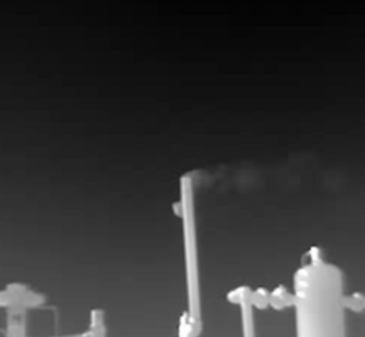
Existing Datasets & Limitations
GasVid
Ideal background
No segmentation ground truth

Slide 4

Existing Datasets & Limitations
GasDB
Not Video
Sample size too small

Slide 5
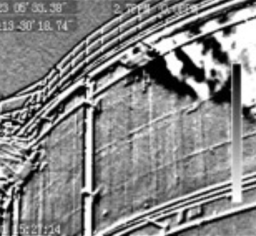
Existing Datasets & Limitations
The Industrial Invisible Gas IIG
No Segmentation Mask
Hand-Held Camera

Slide 6
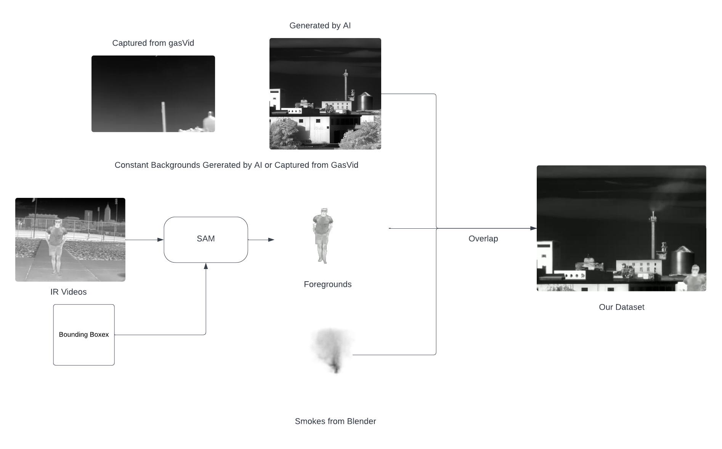
Proposed Dataset: SimGas

Slide 7
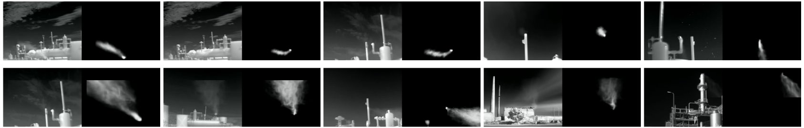
Proposed Dataset: SimGas

Slide 8
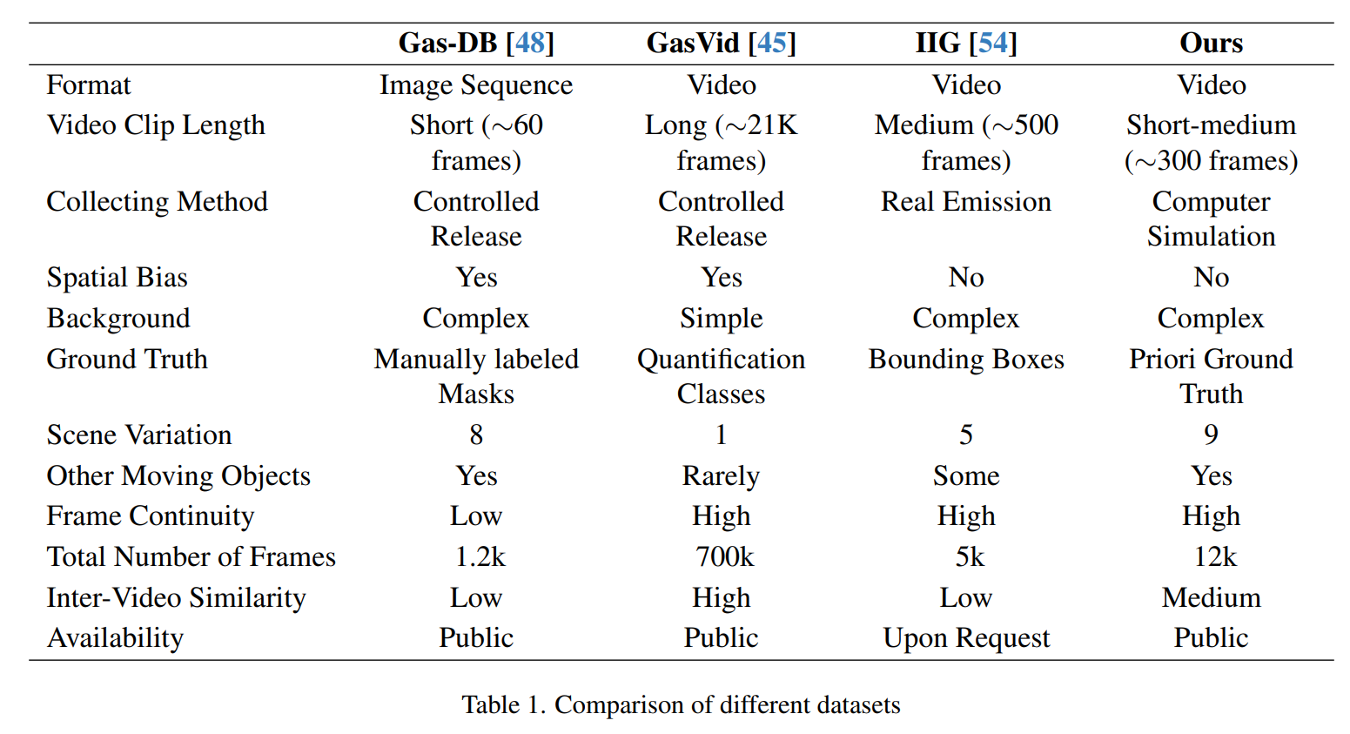
Dataset Comparison

Slide 9
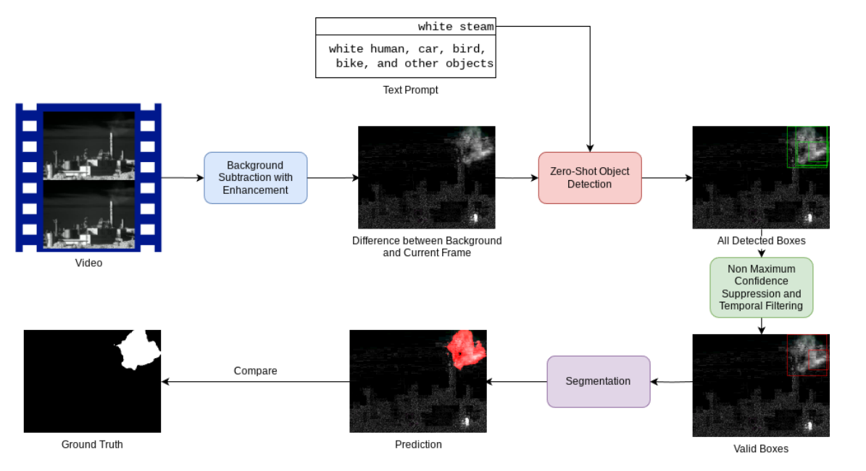
Proposed Method: LangGas

Slide 10
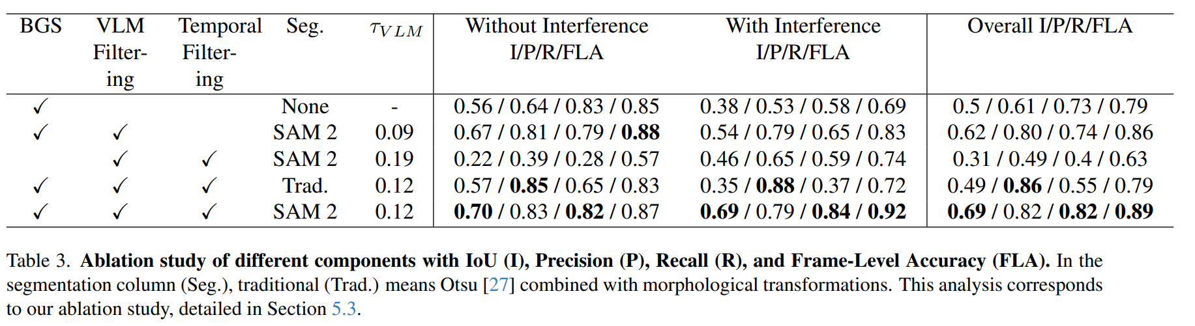
Results

Slide 11
Results and Future Work
https://github.com/weathon/Lang-Gas/blob/main/simgas_preview.md
https://raw.githubusercontent.com/weathon/Lang-Gas/306c1b884ead82a9c8f08914851686a032b2d834/gasvid_res_full/MOV_2559.webp
https://github.com/weathon/vcos

Slide 12
Thanks
Paper and references:
https://arxiv.org/abs/2503.02910
Code and Dataset:
https://github.com/weathon/Lang-Gas
Contacts:
https://github.com/weathon/contact

